Slide 1
Python 101
RNG

Slide 2
last time
logic
yes / no questions (boolean expressions)
conditionals (decision-making)
introduction to dates and objects in python

Slide 3
practice
Notes:
from now on, we always start checking the practice tasks

Slide 4
RNG
random number generation

Slide 5
pseudo random
Notes:
remember this word?
“fake” random

Slide 6
spicy fun fact #1🌶️
random numbers are not truly random
why?
different levels of security, predictability
use cases?
further reading: Wikipedia
Notes:
online casino, statistics, numerical analysis vs video game
wiki article

Slide 7
our RNG function
start
random number
end

Slide 8
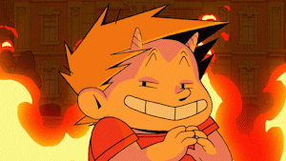
Notes:
we have a built-in function but we circumvent it
it’s good exercise!!

Slide 9
number lines, intervals
Notes:
let’s start with the math

Slide 10
5
6
7
8
9
10

Slide 11
0
1
Notes:
we have this to begin with
what is this line?
what are the circles? (closed vs open)
how many possible results do we have here?
how do we go from here…

Slide 12
5
6
7
8
9
10
Notes:
… to here
we have to use maths!
hint: we need 3 steps

Slide 13
brainstorming

Slide 14
number of integers in an interval
Notes:
how does this help?
what’s the formula to calculate it?

Slide 15
examples
[5, 10]
[1, 6]
[-3, 3]
5, 6, 7, 8, 9, 10 → 6 numbers
1, 2, 3, 4, 5, 6 → 6 numbers
-3, -2, -1, 0, 1, 2, 3 → 7 numbers

Slide 16

$$end −start+1$$
Notes:
okay, how does that help?

Slide 17
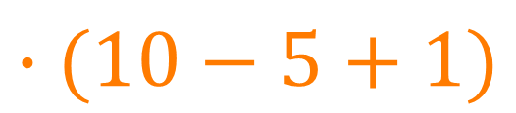
step 1: magnifying
0
1
$$∙(10−5+1)$$
0
1
2
3
4
5
6
Notes:
which integers are within the interval?
[0, 6[
now we have the right amount of possible integers,
but not at the right place

Slide 18
examples
[5, 10]
[1, 6]
[-3, 3]
5, 6, 7, 8, 9, 10 → 6 numbers
1, 2, 3, 4, 5, 6 → 6 numbers
-3, -2, -1, 0, 1, 2, 3 → 7 numbers
Notes:
is this the correct result?
remember, we wanted 6 numbers → these are six numbers

Slide 19
examples
[0, 6[ → [0, 1, 2, 3, 4, 5]
[0, 6[ → [0, 1, 2, 3, 4, 5]
[0, 7[ → [0, 1, 2, 3, 4, 5, 6]
[5, 6, 7, 8, 9, 10]
[1, 2, 3, 4, 5, 6]
[-3, -2, -1, 0, 1, 2, 3]
Notes:
what’s the rule?

Slide 20

$$+start$$

Slide 21
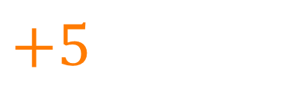
step 2: shifting
0
1
2
3
4
5
6
$$+5$$
5
6
7
8
9
10
11
Notes:
is this what we wanted?
seems ok but still not ready…
okay what’s the problem here?

Slide 22
disregarding non-integers
Notes:
we won’t get into maths, only care about this in python
but just to be complete, see next slide

Slide 23
step 3: disregarding non-integers
5
6
7
8
9
10
11
how?
5
6
7
8
9
10
11
Notes:
what’s the difference?
how can we get there?
two options: rounding / truncating
if we choose rounding, what kind of rounding do we need?

Slide 24

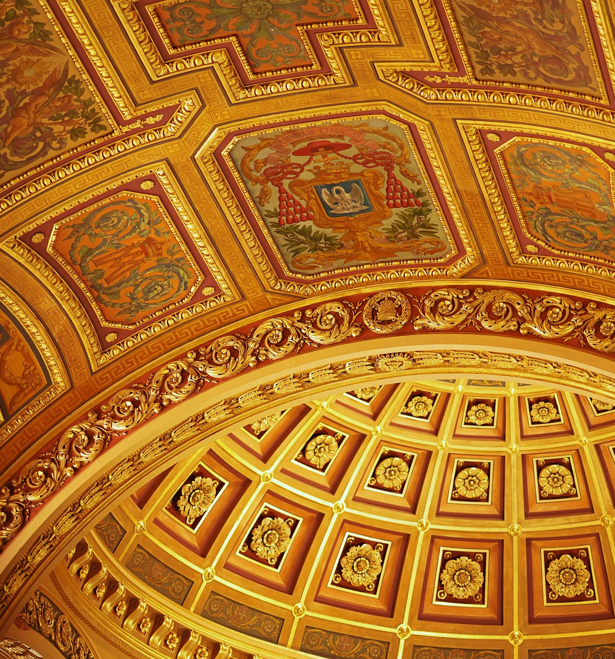
Notes:
floor is always rounding DOWN
ceiling is always rounding UP
disregarding any mathematical rules we might know about rounding

Slide 25
time to code

Slide 26
input
output
Notes:
how does this work for our program?

Slide 27
our RNG function
start
random number
end

Slide 28
import random
Notes:
random module
live code the solution

Slide 29

average user crashing our program
Notes:
who’s this?
don’t mind him…

Slide 30

$$start=7; end=3$$
what happens?
Notes:
do the math
how could we prevent this from happening?

Slide 31





Notes:
hamster vs snake problem
how do we deal with it?

Slide 32
swapping variables
Notes:
multiple ways to do that

Slide 33
our first game
computer “thinks” of a number between 1 and 20
you have to guess the number
you can score 100 points if you nail your guess
otherwise, you lose 10 points per distance
you can’t score less than 0 points

Slide 34
examples
number: 17 guess: 10 score: 30
number: 5 guess: 5 score: 100
number: 1 guess: 19 score: 0
number: 20 guess: 18 score: 80
Notes:
do the live coding

Slide 35
what we learned today
RNG, simulating dice rolls
testing, thinking outside the box
preparing for the worst
making a small RNG-based game

Slide 36
next time
repeating patterns, loops
2 different use cases for loops
using our own code as modules
revisiting Bob and of course…
99 bottles of beer!

Slide 37
“practice makes perfect”
— some random teacher, probably
Notes:
motivational quote

Slide 38
Sources
Evil GIF: https://giphy.com/gifs/smartypants-lavieenslip-XVbQsIjdXDNyswwxOO. Downloaded on 3 May 2023.
Floor: https://pixabay.com/photos/space-empty-wooden-floor-plant-3197611/. Downloaded on 3 May 2023.
Ceiling: https://pixabay.com/photos/cathedral-church-ceiling-dome-7498794/. Downloaded on 3 May 2023.
Users: https://giphy.com/gifs/deal-with-it-computer-sunglasses-10FwycrnAkpshW. Downloaded on 3 May 2023.
Box: https://pixabay.com/vectors/box-cardboard-open-brown-box-1297327/. Downloaded on 3 May 2023.

Slide 39
Sources
Snake: https://pixabay.com/vectors/cartoon-snake-yellow-1293047/. Downloaded on 3 May 2023.
Hamster: https://pixabay.com/illustrations/hamster-cute-sweet-animal-pet-1151309/. Downloaded on 3 May 2023.

